Slide 1
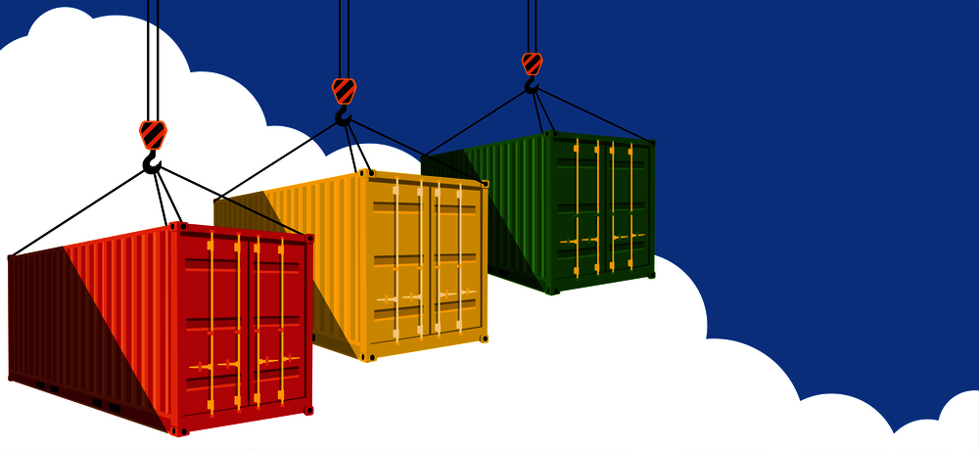
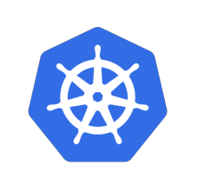
Containers & Kubernetes

Slide 2
Session Overview
Need of containers?
What are containers?
Working of containers
Images
Docker
Kubernetes overview
Master nodes
Worker nodes
Objects of Kubernetes
Q &A

Slide 3
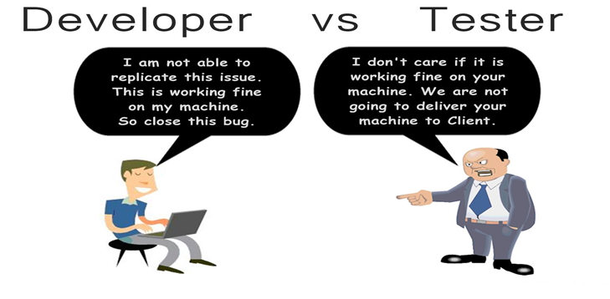

Slide 4
Need of Containers
Bad Old days
For every new application need to buy a new servers
More expensive and time consuming
Requires more time to deployments
Virtualization solved few problems
For every new application need new VM instance
Less expensive as compare to physical servers
Requires less time for deployments
Wastage of server resources
Containers
All about isolation (will get back to it shortly)
More efficient than VM and Physical servers
Requires very small time for deployment

Slide 6
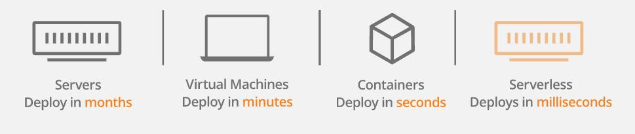
Benefits of using containers

Slide 7
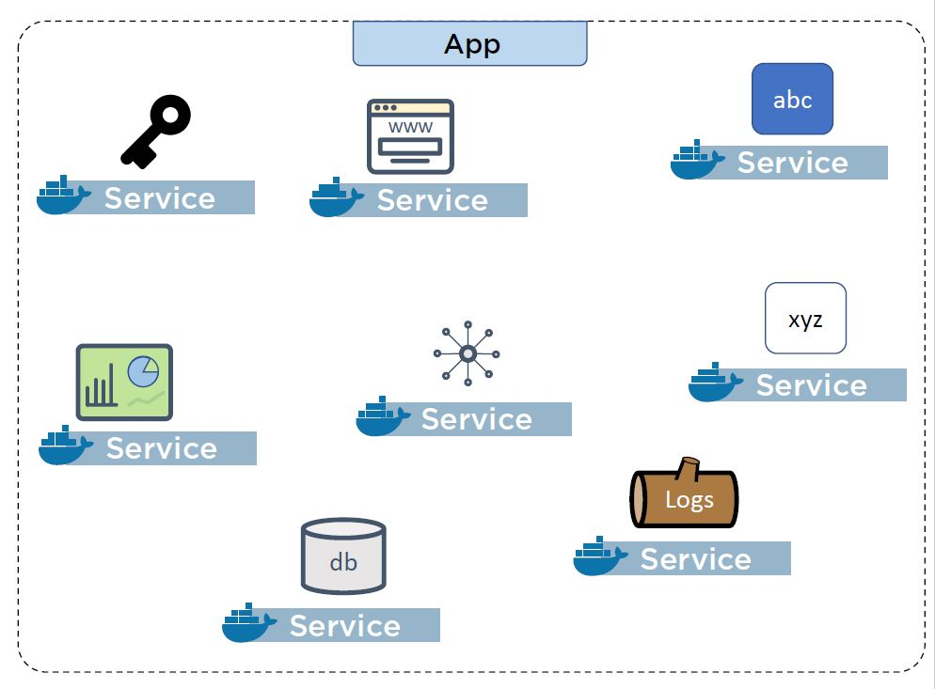
Easy to implement microservice architecture

Slide 8
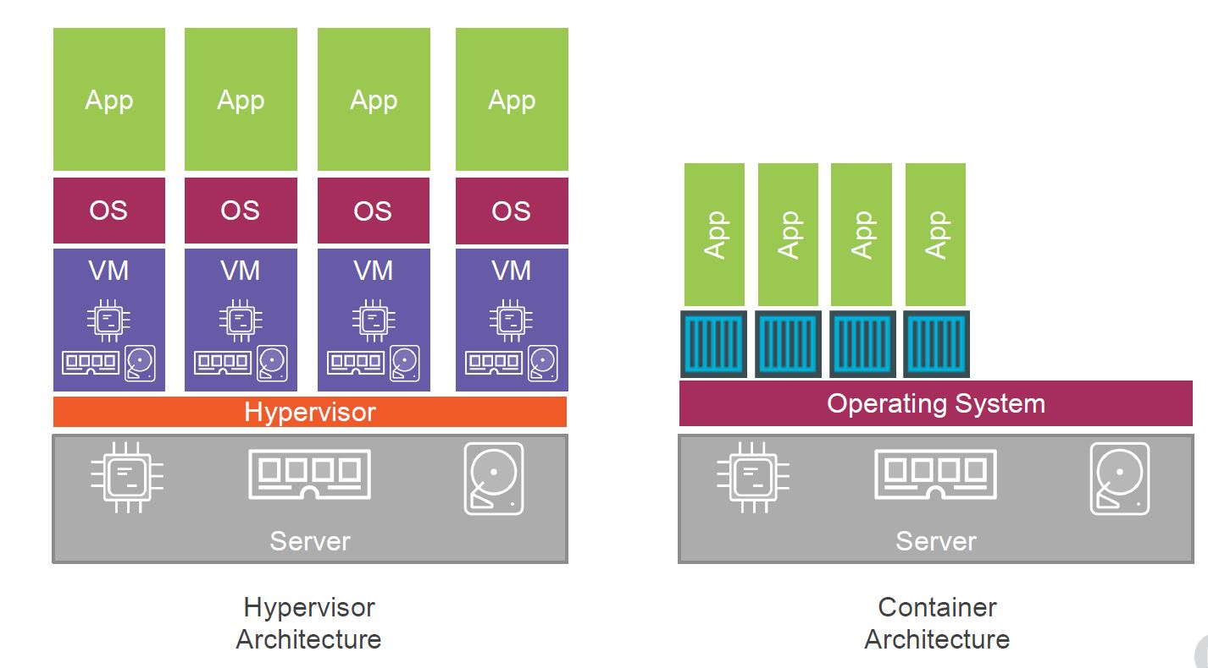
Comparision of Virtualization and Containers

Slide 9
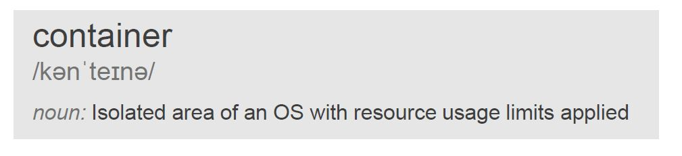
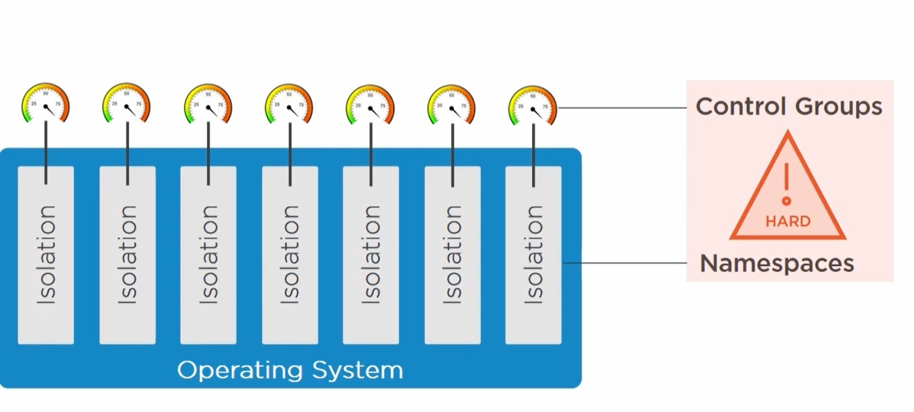
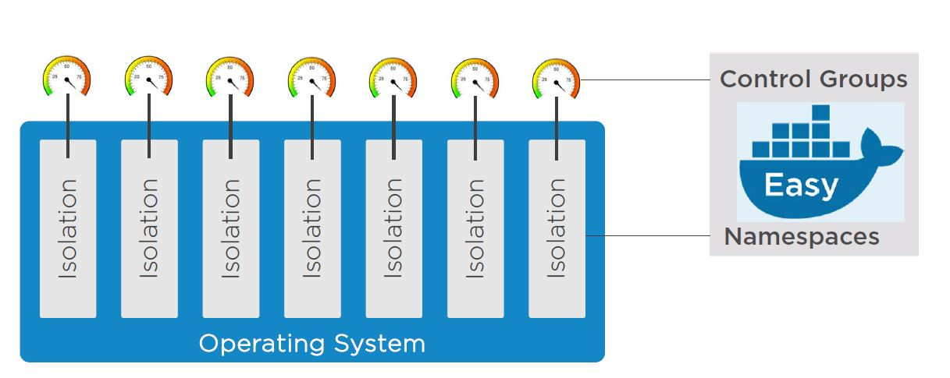

2) What are containers?

Slide 10
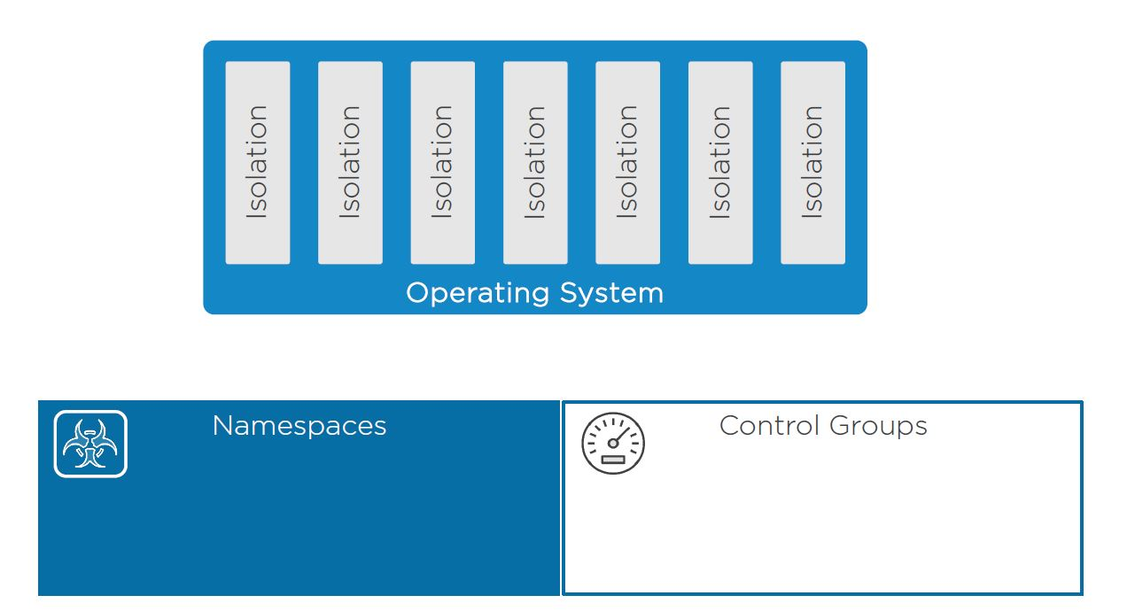
3) How containers works internally
Containers works on following OS kernel primitives of the host machine
Namespaces
Control Groups

Slide 11
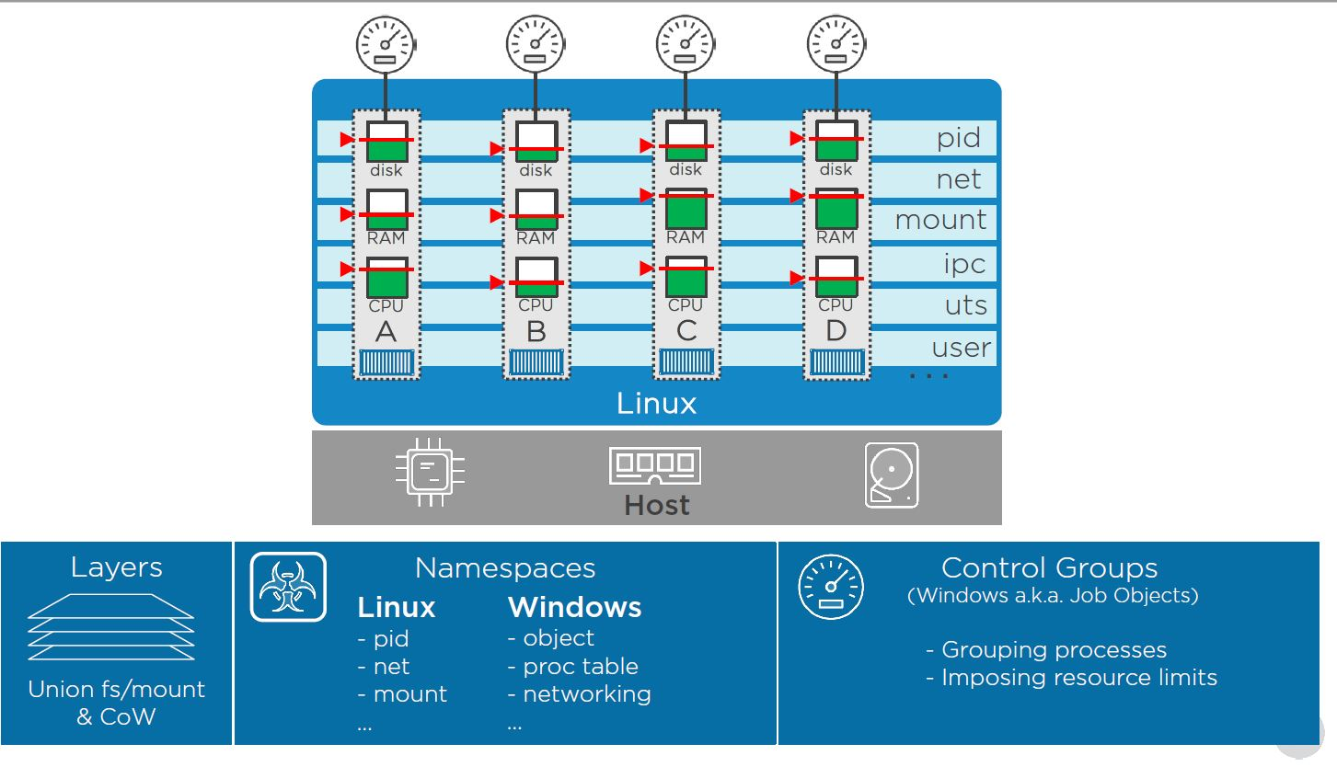
Control Groups

Slide 12
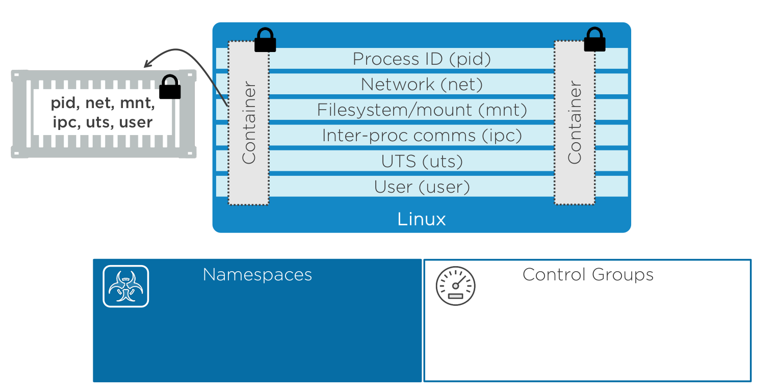
Internals Of Container

Slide 13
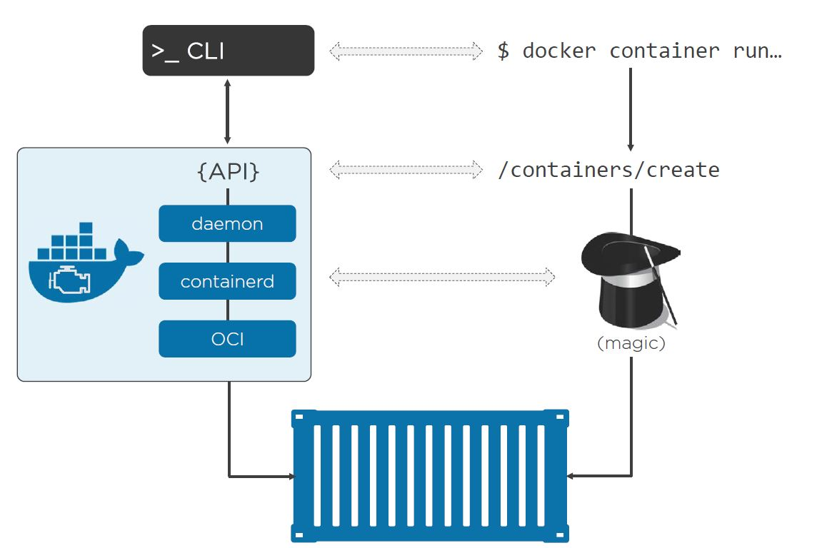
Docker

Slide 14
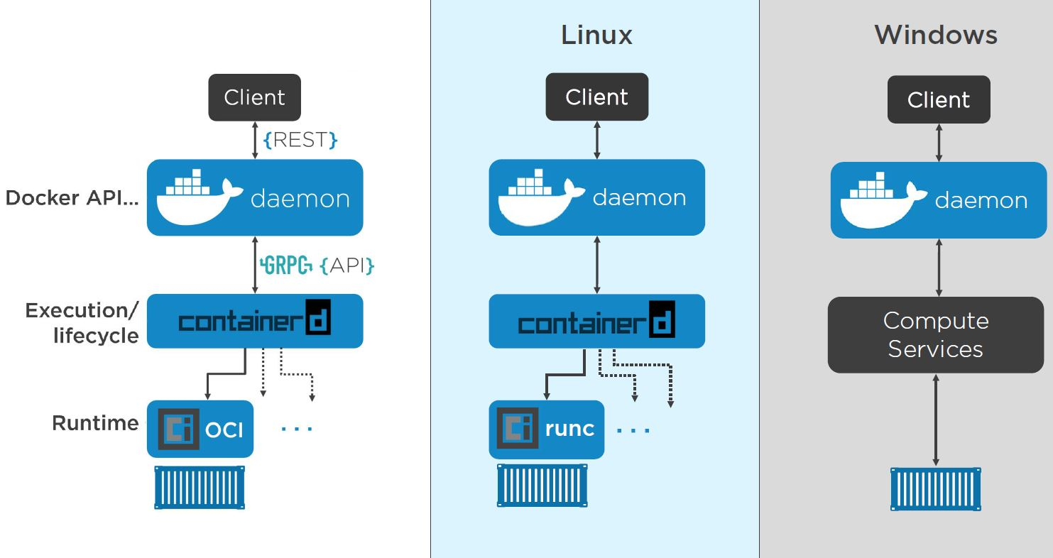
OCI(Open Container initiative)

Slide 15
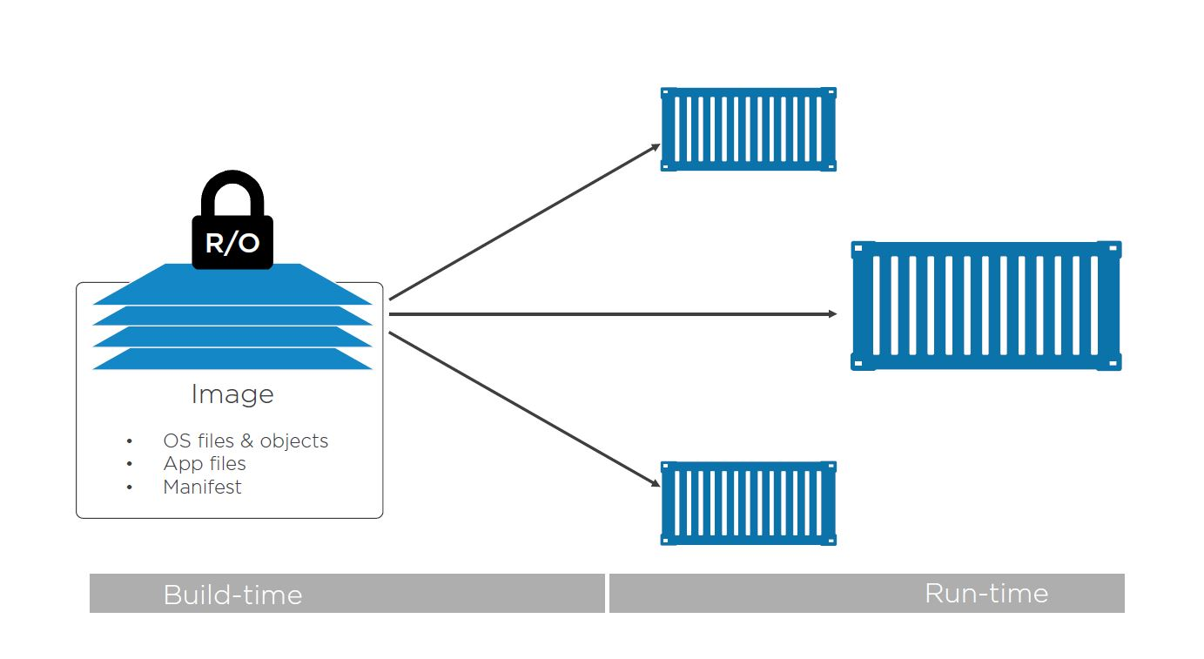
Conitainer Images
In the container, an image is effectively a stopped container. If you’re a developer, you can think of an image as a class.

Slide 16
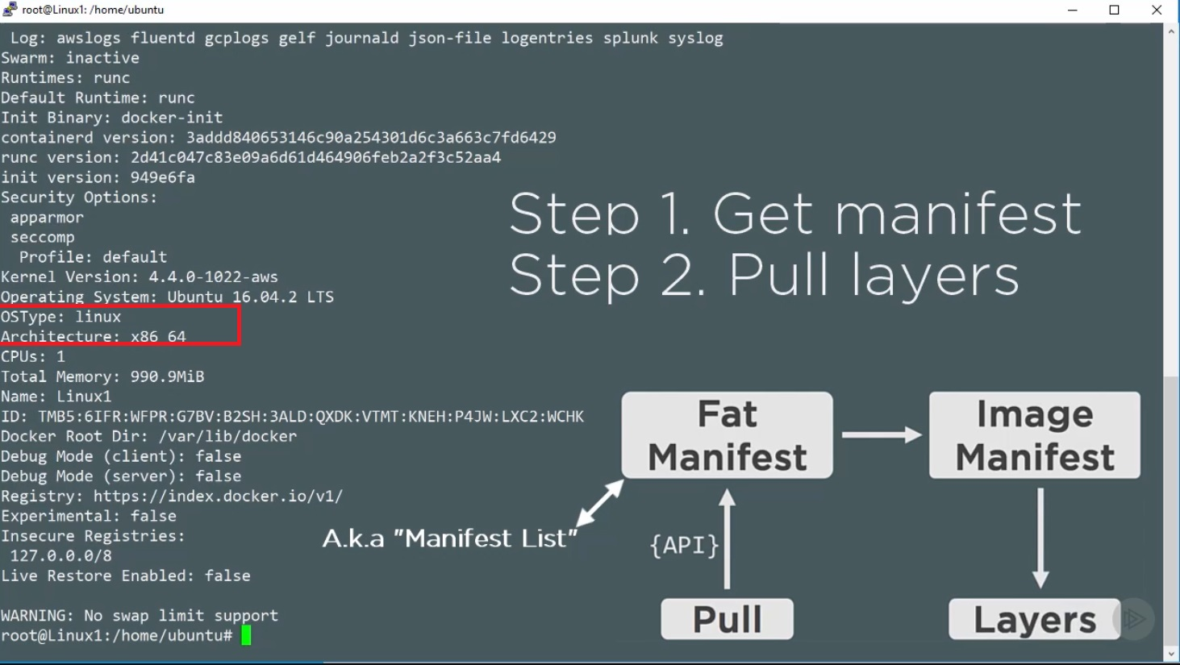
Pulling Images

Slide 17
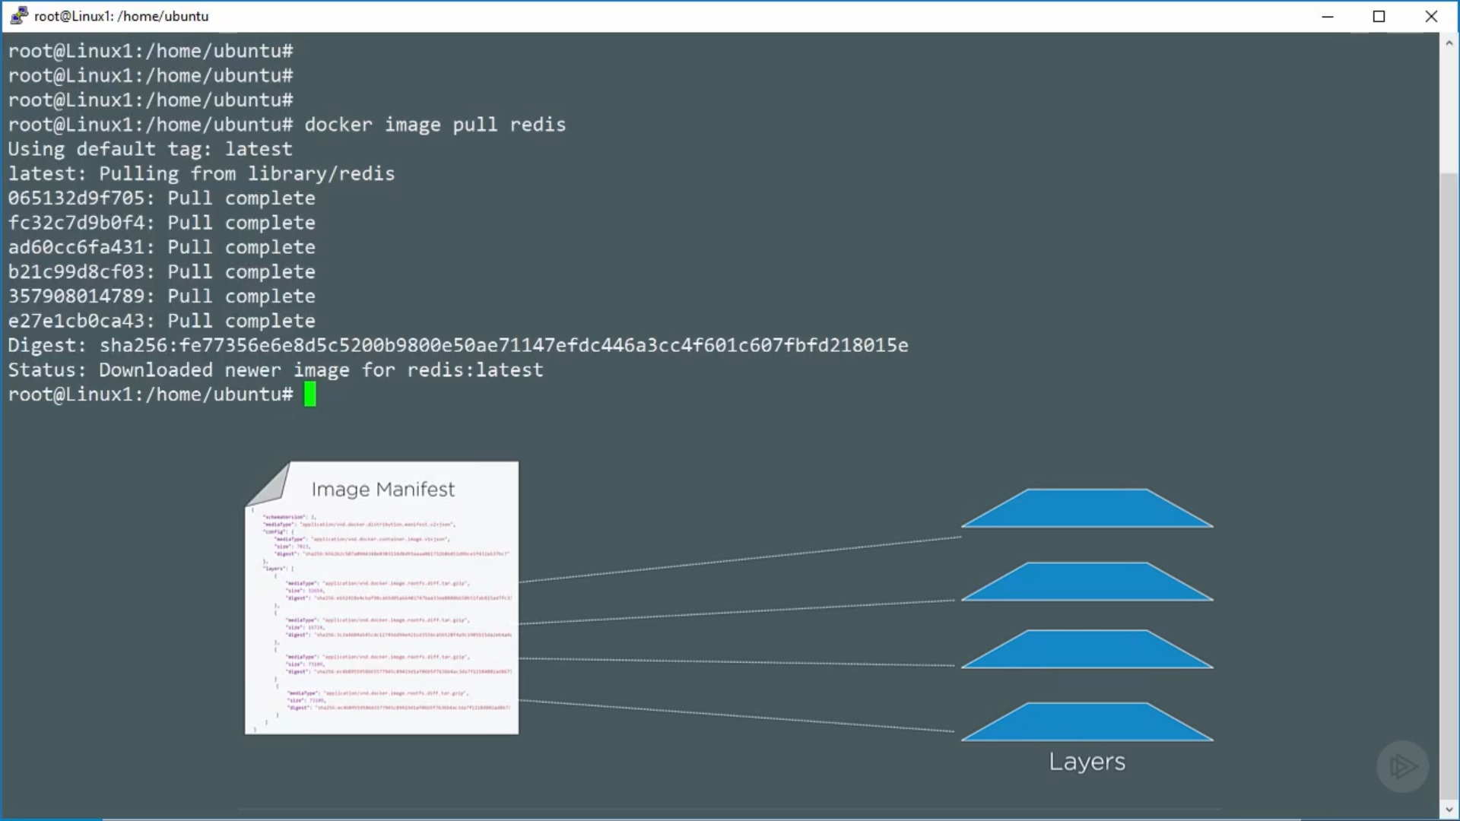

Slide 18
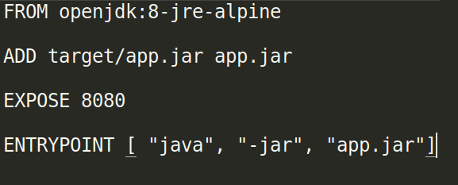
How to build custom images
Docker file

Slide 19
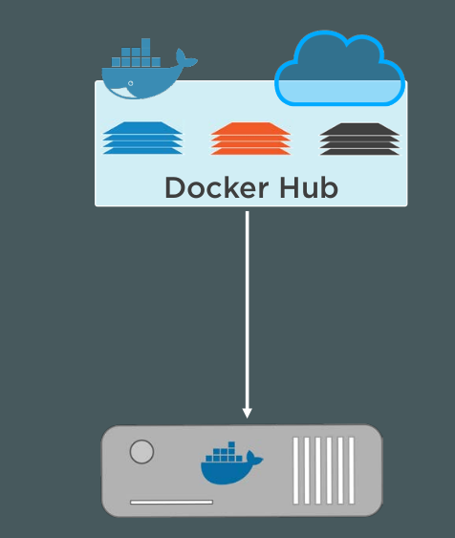
Docker registries

Slide 20
Some Dokcer Commands
docker run -d -p 8080:80 nginx:latest
docker run -d -p 8080:80 -v hostFolderPath:containerPath:ro --name server nginx
docker exec -it server(name of running container) bash
Docker ps
docker build -t website:latest .

Slide 21
Kubernets Overview
Kubernetes supports container runtimes such as containerd, CRI-O, and any other implementation of the Kubernetes CRI (Container Runtime Interface)
Orchestration tool
Easy to use

Slide 22
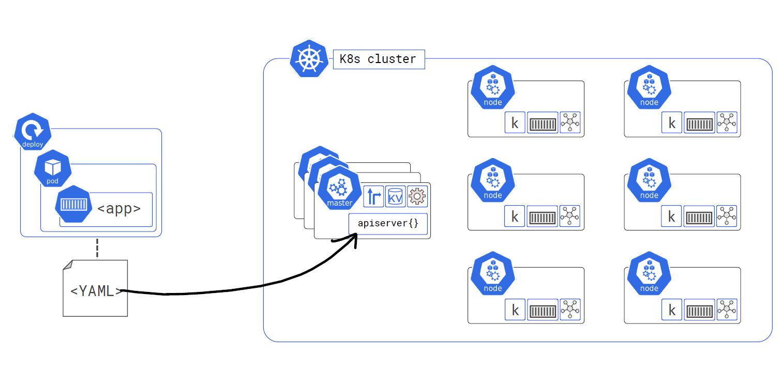
Kubernetes Architecture

Slide 23
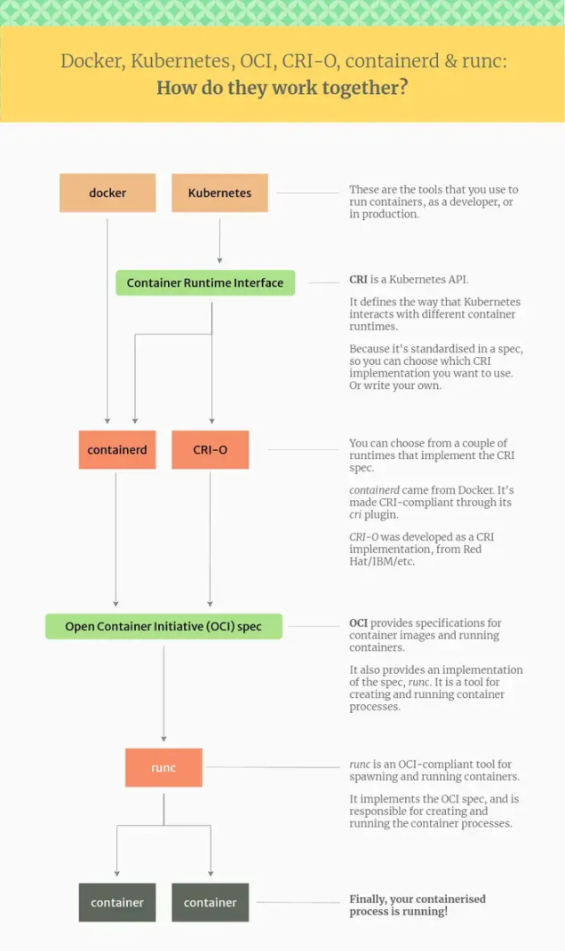

Slide 24
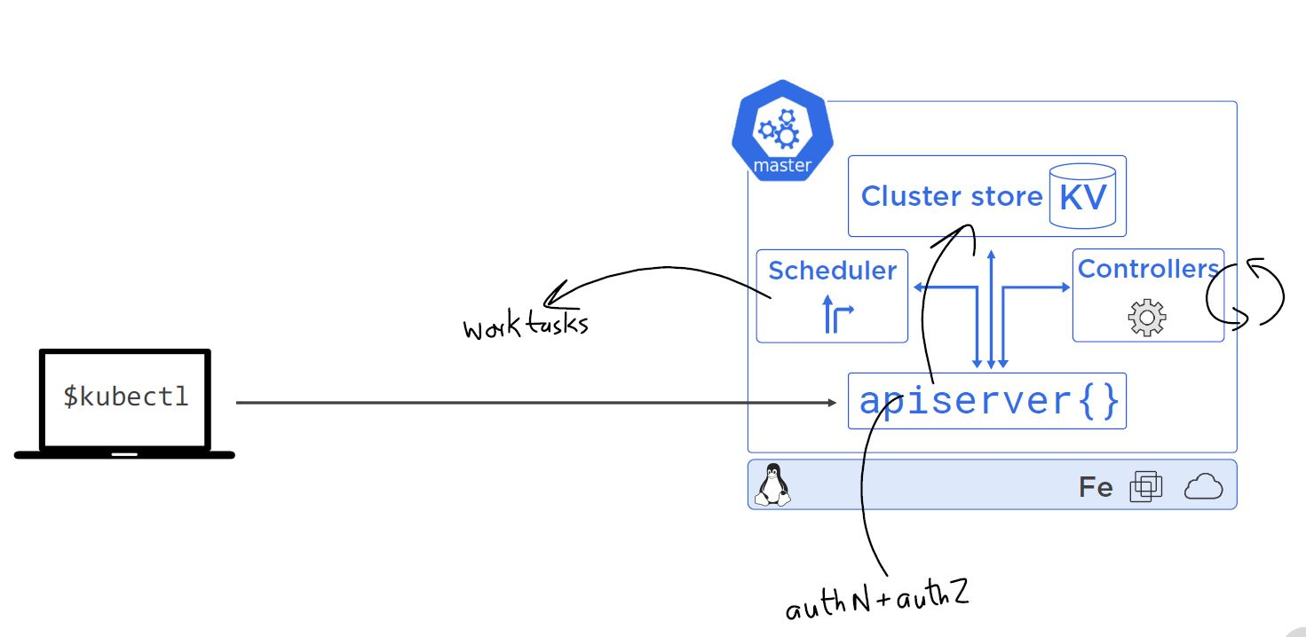
Master Nodes

Slide 25
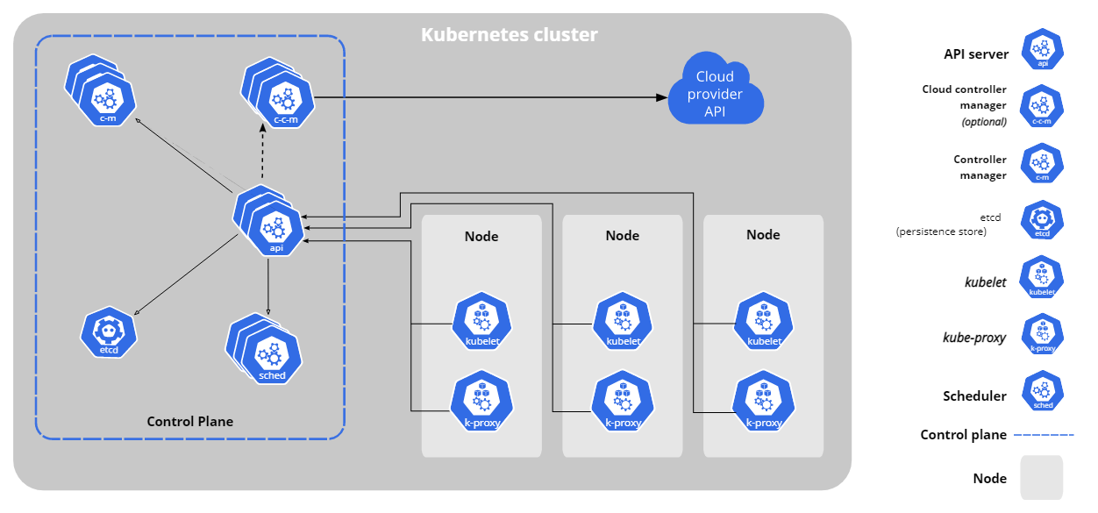

Slide 26
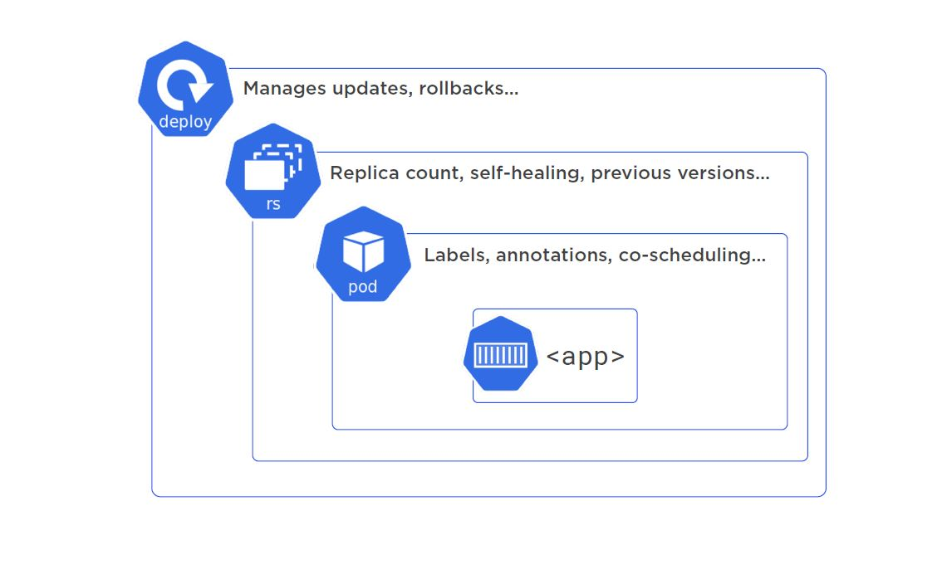

Slide 27
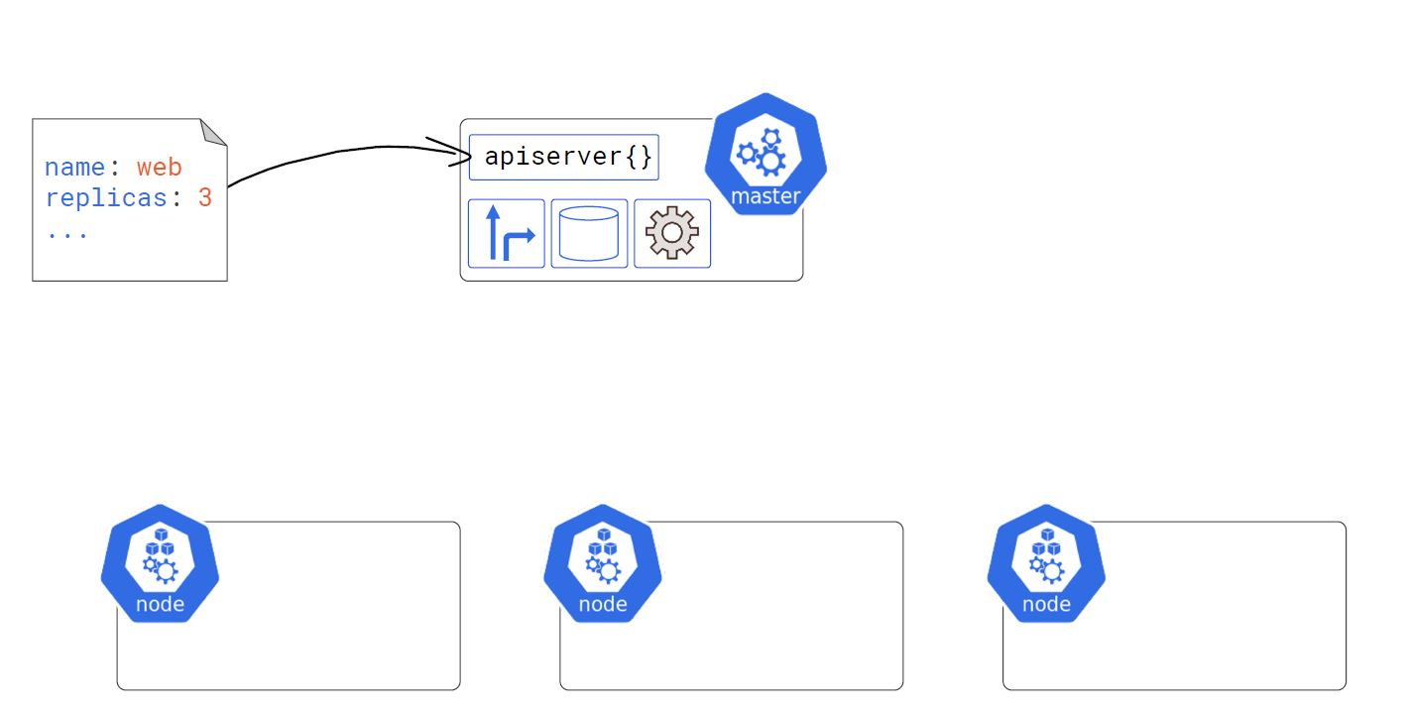
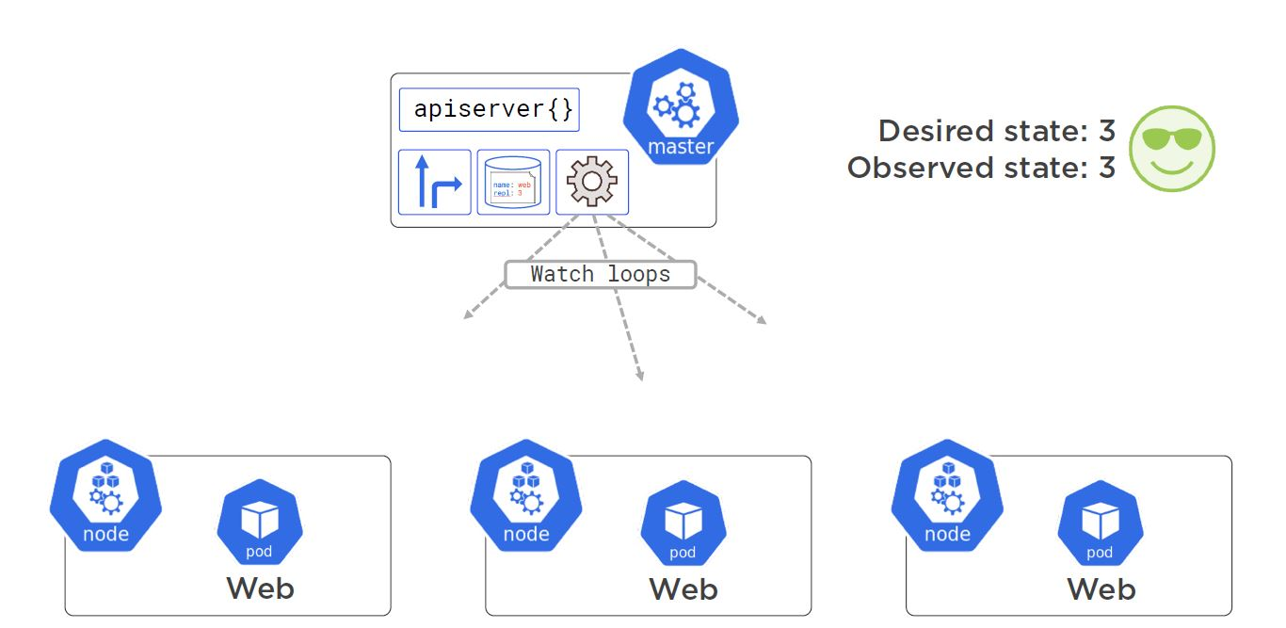

Slide 28
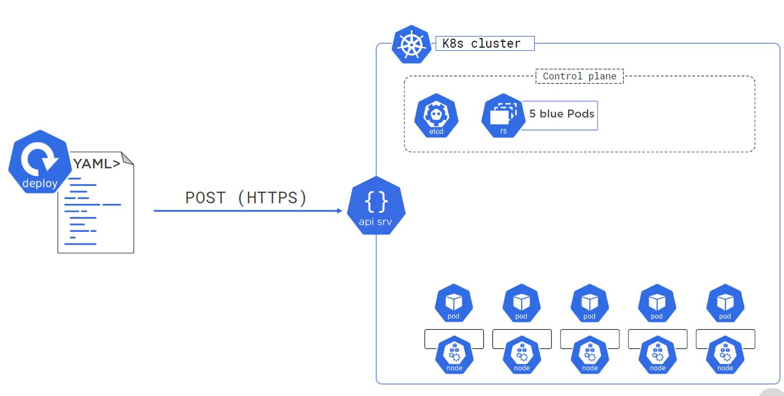
Application deploy and roll back

Slide 29
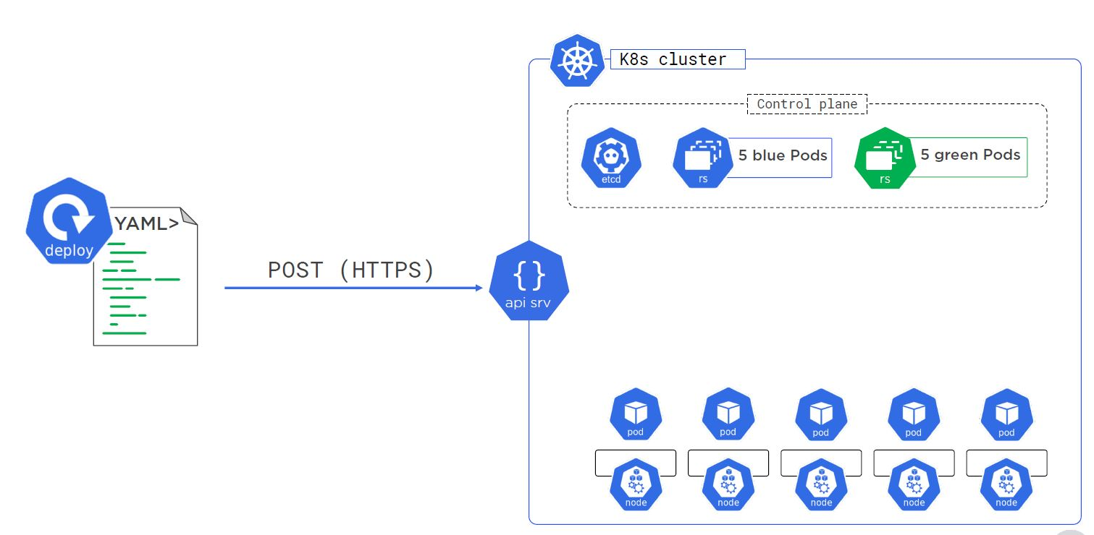

Slide 30
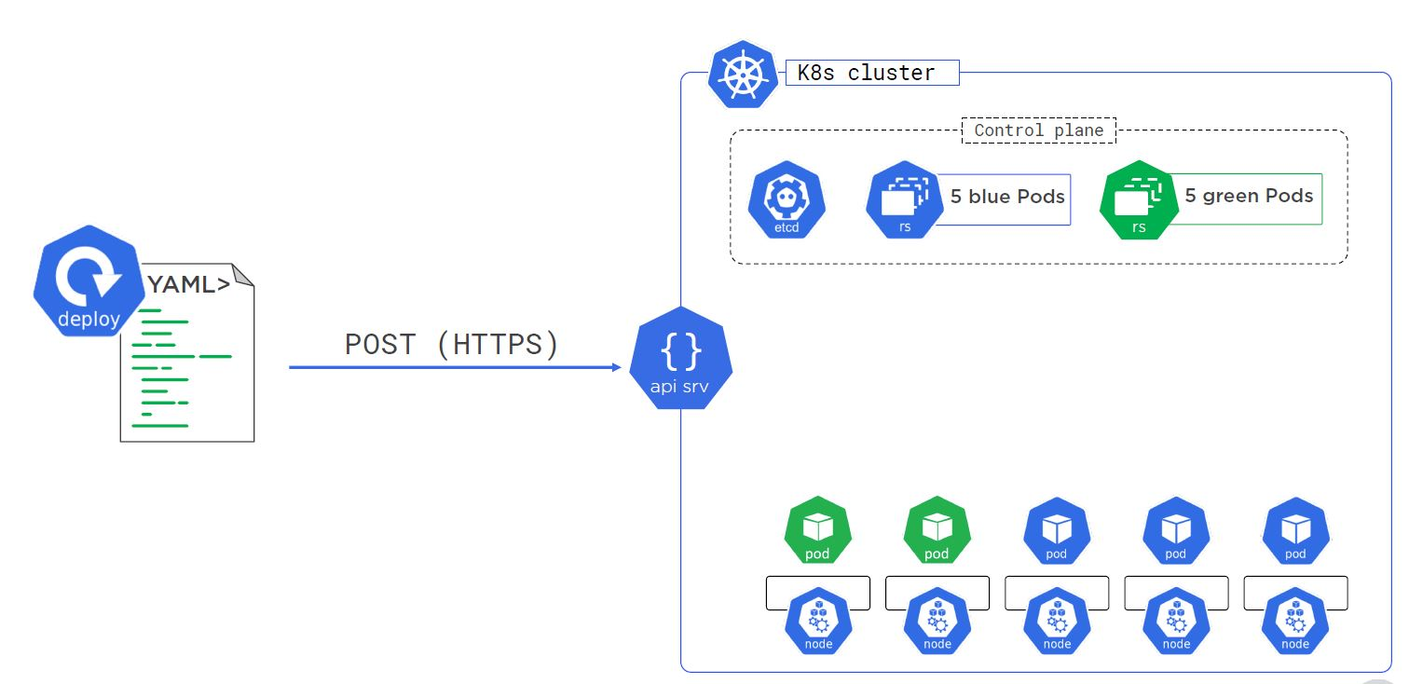

Slide 31
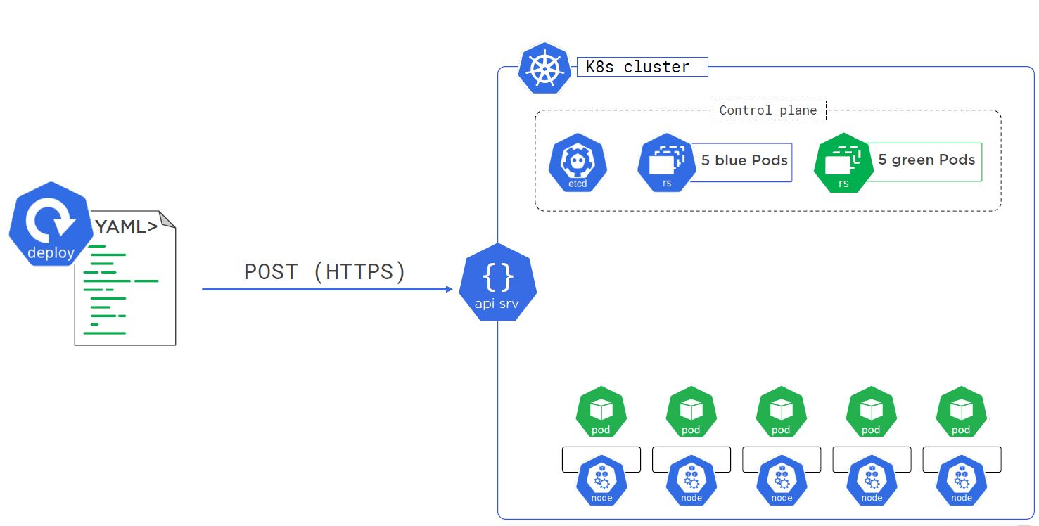

Slide 32
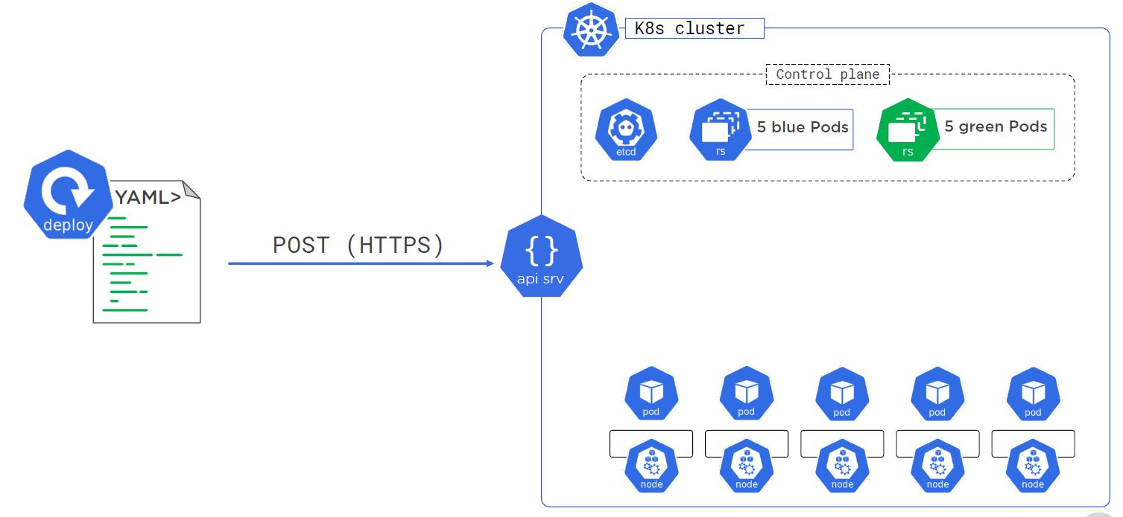

Slide 33
Helm charts
Helm uses a packaging format called charts
A chart is a collection of files that describe a related set of Kubernetes resources

Slide 34
DEMO

Slide 35
Thank You

